Slide 1
CS 117
Class Project Examples
Mobile Applications on Android

Slide 2
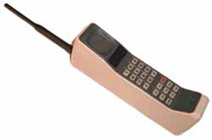
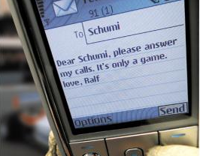
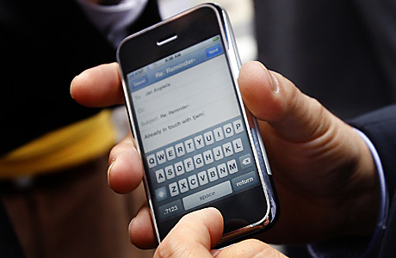

Mobile Device Evolution
Mobile Phone Users (Billion)
4
3
2
1
2000 2009 2015
New uses for mobile computing
You will be asked to develop an application on a Smartphone.

Slide 3
Project Examples from Previous Classes

Slide 4
1. Mobile Activity Monitor

Slide 5
Activity Monitoring
Use the android smart-phone as a data collection device
Run a software pedometer to classify and count steps
Upload hourly step counts to central server
Provide interesting statistics and views
Focus: Ease of use, non-interference

Slide 6
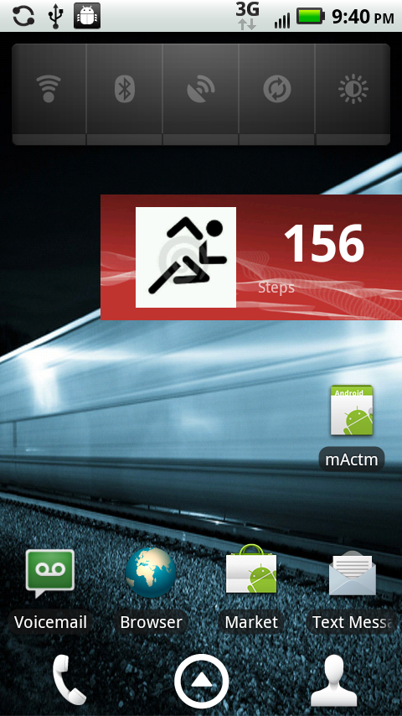
Android Pedometer Module
Pedometer Widget displaying steps on Home Screen
Count reset at the end of each hour
Screen scrape of the android display shown on the right

Slide 7
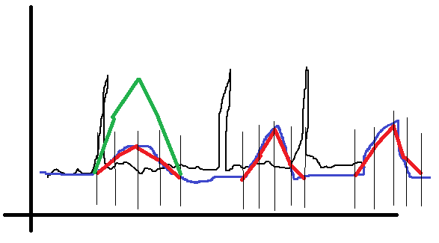
Android Pedometer Module
Accelerometer Sensor Service
High Resolution Accelerometer values
Process:
  Apply Kalman filter
  Calculate magnitude
  Calculate moving average based on window
  Filter based on moving average window (spike type classifier)
  Different thresholds
Green -> Run threshold
Red -> Walk threshold
Blue -> Moving average
Black -> Accelerometer data

Slide 8
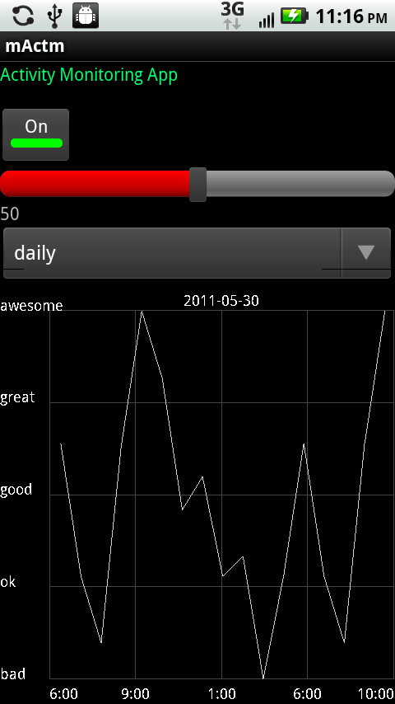
Android User-Interface &
Data Display
Provides control over the Activity Monitor
Control over the pedometer sensitivity
Choice of views: daily, weekly, monthly
Graphical Representation.
Metrics that make more sense

Slide 9
2. Ambient Radiation Monitoring

Slide 10
Motivations
Recent studies show that radiation from WiFi is harmful to trees.
Impact of wireless radiation on humans are still controversial.
  It may be harmful or not
It would be helpful if we have a radiation map

Slide 11

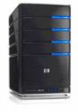
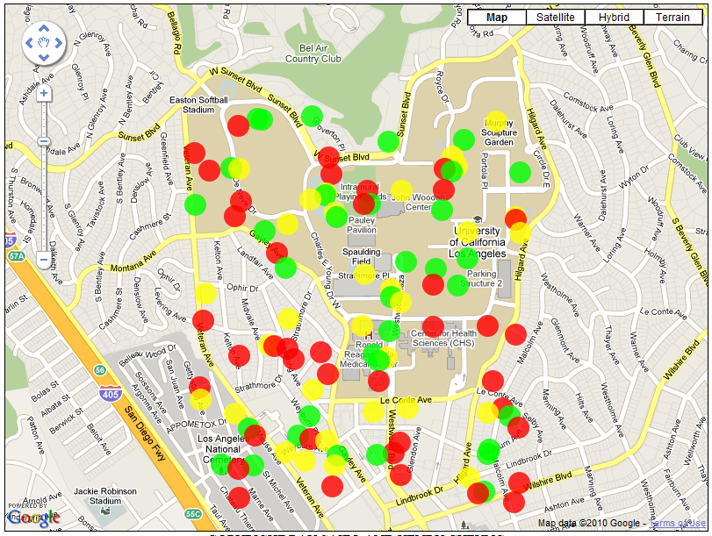
System Implementations
1. WiFi and Cellular
Signal Collection
2. Transfer Data to Server
Smart phones move around
3. Draw Radiation Map
4. Display Map Online

Slide 12
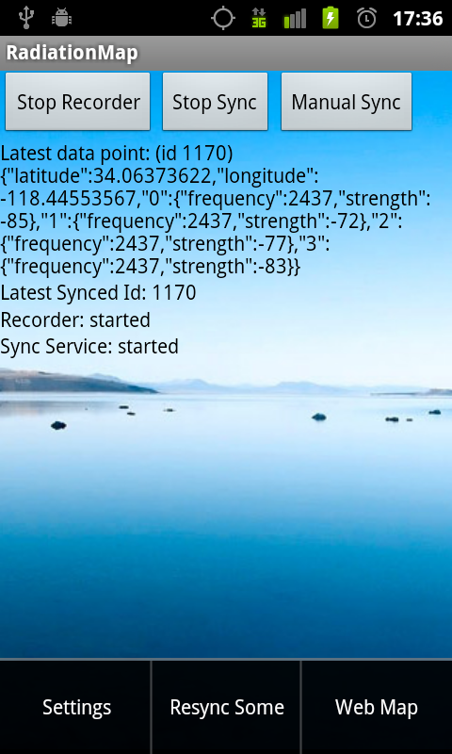
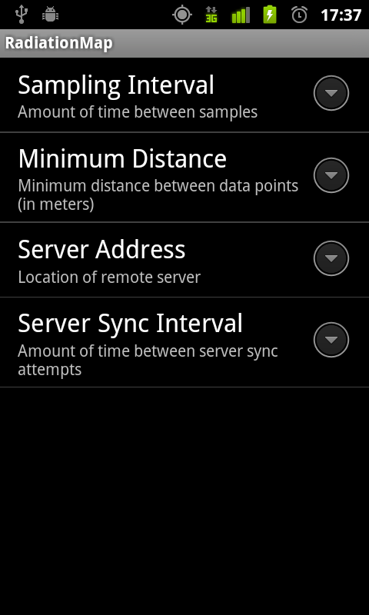
User Interface

Slide 13

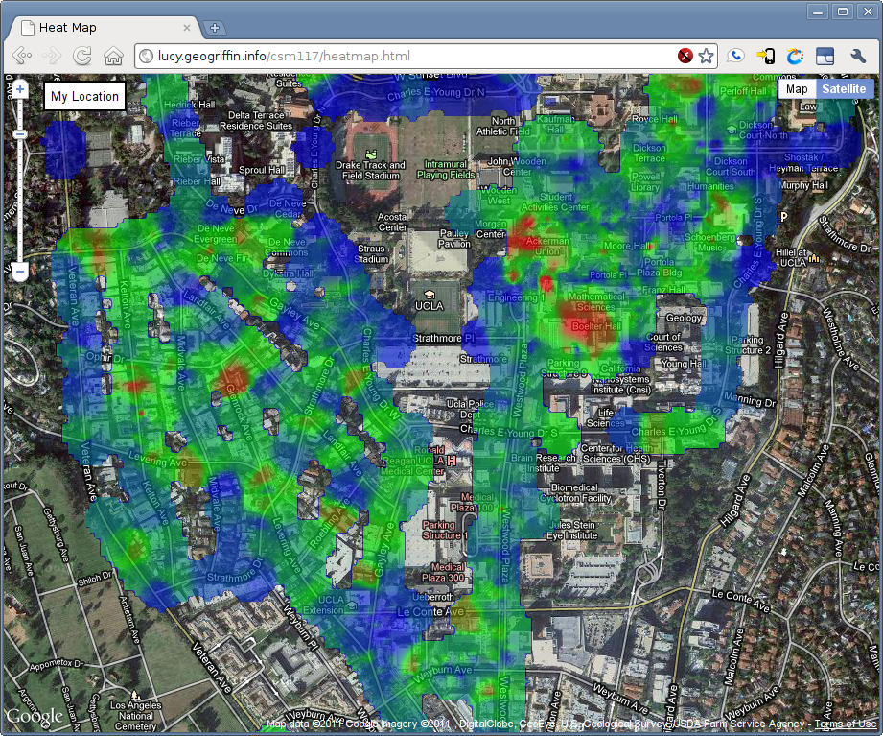

Final Product

Slide 14
Propose your projects!!

Slide 15
Project Requirements
Smart phone application
  You can use other platforms, e.g. iPhone or Windows mobile, if you have phones
Wireless Communications OR Health related issues
  It’s recommended to use at least one wireless interface
    Upload data to web server via WiFi
    Communication between two phones over BT or WiFi
  But NOT limited to wireless interface
    If you use at least one of the sensors on the phone
    e.g.) Accelerometer, 3-axis gyroscope, GPS, Digital compass, NFC, Camera, Microphone etc.

Slide 16
Lab Devices
NFC tags
Two phones will be issued per Group
  (10) Samsung Nexus S with NFC capability
  (Android 2.3.4)
  (10) Samsung Galaxy SII (Android 2.3.4)
  (10) Motorola Droid Bionic
  with unlimited Data plan (Android 2.3.4)
  (1) iPad2 & (1) Galaxy tab 10.1
  More Android phones may be available

Slide 17
Project Schedule
Week | Tuesday | Wednesday | Thursday
4 | 01/31 Teams formed & Project design proposed | 02/01 Lab # 3 BT PAN REP due on 02/08/12 | 02/02 Projects proposed by students
5 | 02/07 Equipments handed out | 02/08 No class | 02/09
6 | 02/14 | 02/15 No class | 02/16
7 | 02/21 Progress presentations by students | 02/22 No class | 02/23
8 | 02/28 | 02/29 No class | 03/01
9 | 03/06 | 03/07 No class | 03/08
10 | 03/13 Final presentations (1) | 03/14 Quiz test | 03/15 Final presentations (2)
Finals week |  |  | 03/22 Project reports submission due

Slide 18
CS 117 Project Grading Policy
Project – 50% of the total grading
Attendance – 10%
  You should come Tuesdays and Thursdays
  You may be absent up to two times.
Proposal presentation – 10%
Progress presentation & discussion – 20%
Final Presentation – 40%
  Group presentation
  all members will participate
  up to 20 minutes
Final Report (Friday of finals week) – 20%

Slide 19
Recommendation
Start EARLY
  Find your team members (4 students) by Jan 31st.
  Get familiar with mobile app development
    Android SDK
    Java language
    http://developer.android.com/
  Think about your project
    Let me know if you have an idea!

Slide 20
Contact Information
Seongwon Han
  swhancs@gmail.com
Sungwon Yang
  swyang@cs.ucla.edu

